Slide 1
Early Detection of Medication Nonadherence
Andrew Zimolzak
Committee: Ken Mandl
Aurel Cami
Sebastian Schneeweiss

Slide 2
Adherence is good.
1

Slide 3


Slide 4

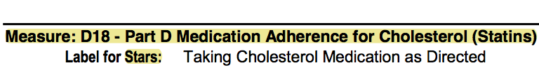

Slide 5
Nonadherence is common.
2

Slide 6
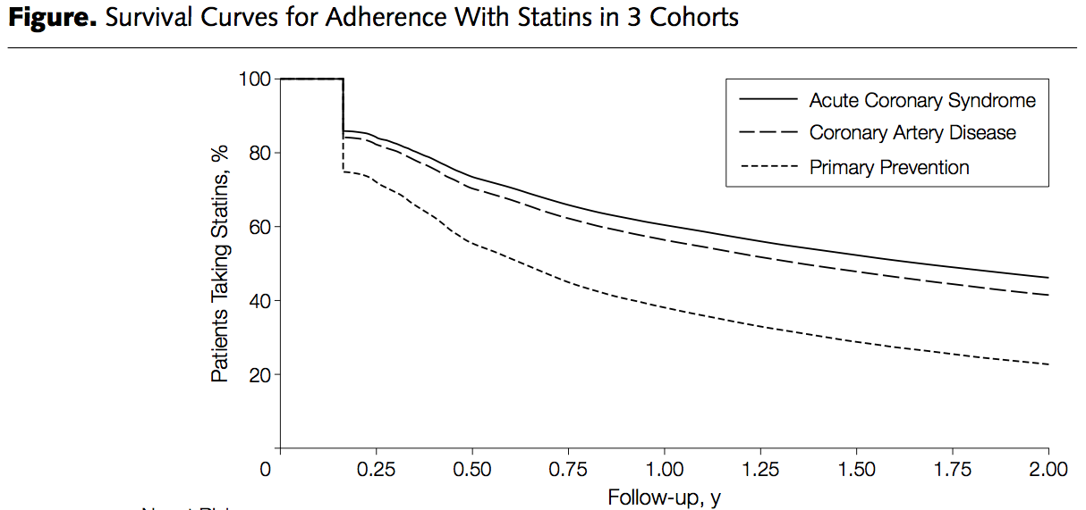
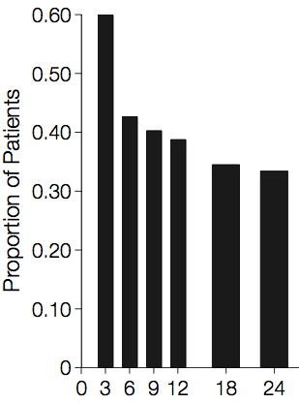
55%
45%
Benner et al. JAMA (2002) 288:455.
Jackevicius et al. JAMA (2002) 288:462.

Slide 7
There is no gold standard measure of adherence.
3

Slide 8
Adherence Measures
1. Prescription Fills (claims)
2.
3.
4.
5.

Slide 9
Adherence Measures
1. Prescription Fills (claims)
2. Pill counts
3.
4.
5.

Slide 10
Adherence Measures
1. Prescription Fills (claims)
2. Pill counts
3. Self-report
4.
5.

Slide 11
Adherence Measures
1. Prescription Fills (claims)
2. Pill counts
3. Self-report
4. Drug levels
5.

Slide 12
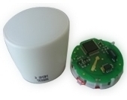
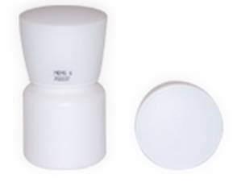
Adherence Measures
1. Prescription Fills (claims)
2. Pill counts
3. Self-report
4. Drug levels
5. Electronic monitoring
aardexgroup.com

Slide 13
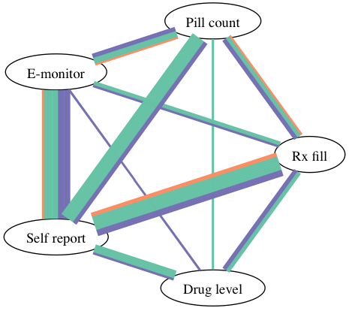

Slide 14
Adherence interventions work but can be complex.
4

Slide 15
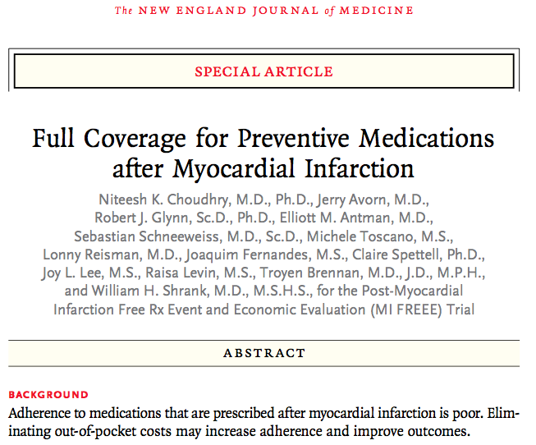

Slide 16
Some predictors of adherence don’t work.
5

Slide 17
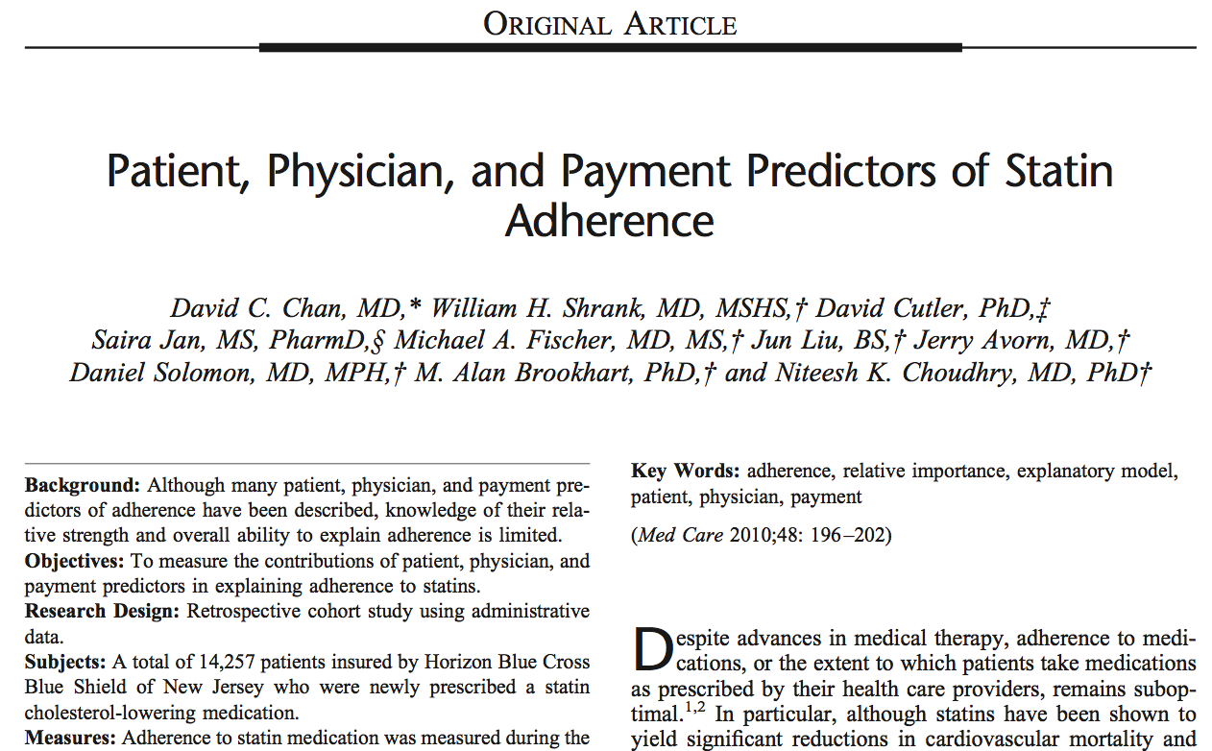

Slide 18
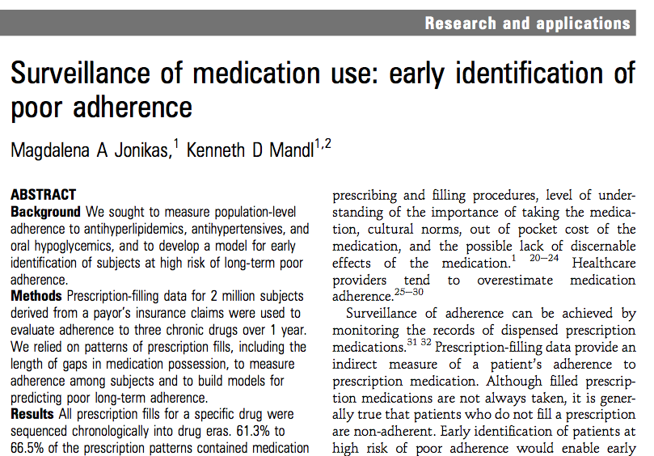

Slide 19
Assessed for eligibility (n= 624 781)
Excluded (n= 406 853)
Washout period < 180 d (n= 388 012)
Eligibility < 90 d after index date (n= 17 397)
Eligibility gap in first yr (n= 3032)
Fill quantity > 100 (n= 899)
Lovastatin (n= 48)
Unknown gender (n= 3)
Age > 100 (n= 3)

Slide 20
Eligible (n= 217 928)
Training set (n= 145 324)
Validation set (n= 72 604)

Slide 21
Characteristic | n = 217,928
Age, median (IQR) | 56 (49 – 62)
Women | 45%
Simvastatin | 58%
Rosuvastatin | 24%
Atorvastatin | 16%
Other statins | 2%
Pills per day, median (IQR) | 0.4 (0.0 – 1.8)
Recent heart attack | 2%

Slide 22
Characteristic | n = 217,928
Adherence for 1-90, median (IQR) | 0.87 (0.59 – 1.00)
Poor adherence for 91-365 | 48%
Good adherence for 91-365 | 22%
Left insurance plan in 91-365 | 30%

Slide 23
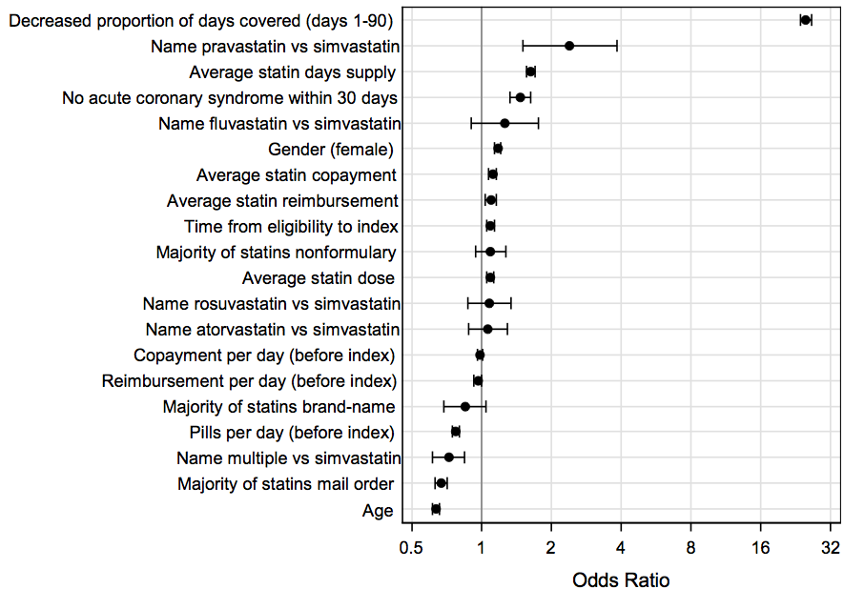
Early monitoring = strongest odds
Bad
Good

Slide 24
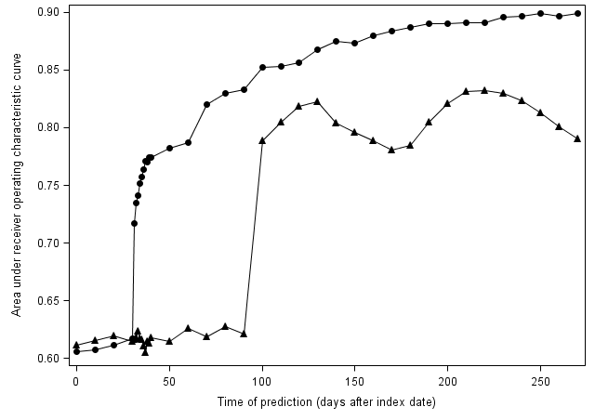

Slide 25
 | Nonadherent | Adherent | Left plan | Total
Predicted nonadherent | 334 | 47 | 180 | 561
Predicted adherent | 148 | 168 | 123 | 439
Total | 482 | 215 | 303 | 1000

Slide 26
Discussion

Slide 27
Thank you! To:
Ken Mandl
Aurel Cami
Sebastian Schneeweiss
Alexa McCray
Katherine Flannery
Aimee Doe
Marisa DiSarno
BIRT staff
Seminar classmates
CHIP colleagues
Elizabeth Moulton

